Slide 1

Introduction to Arduino IDE
LECTURE-4

Slide 2
Introduction to Arduino IDE
Arduino IDE is an open source software that is mainly used for writing and compiling the code into the Arduino Board(s).
It is an official Arduino software, and makes code compilation so easy that even a common person with no prior technical knowledge can learn it.
It is easily available for operating systems like MAC, Windows, Linux and comes with inbuilt functions and commands that play a vital role for debugging, editing and compiling the code in the environment.

Slide 3
Introduction to Arduino IDE
The main code, also known as a sketch, created on the IDE platform will ultimately generate a Hex File which is then transferred and uploaded in the controller on the board.
The IDE environment mainly contains two basic parts: Editor and Compiler where former is used for writing the required code and later is used for compiling and uploading the code into the given Arduino Module.
This environment supports both C and C++ languages.

Slide 4
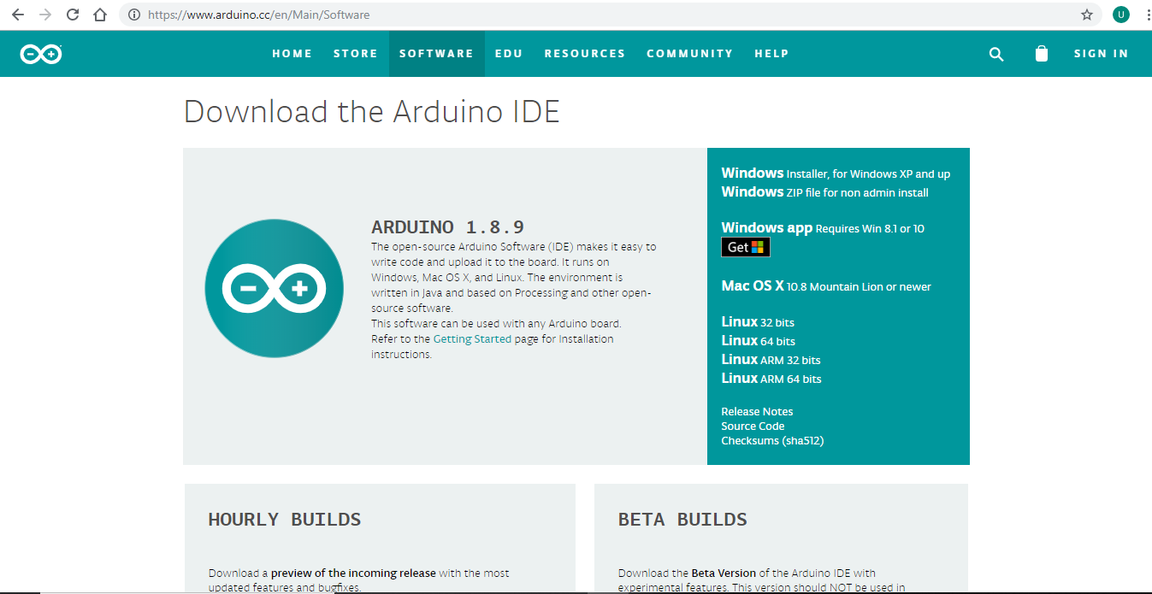
How to download Arduino IDE
Go to the Arduino Download Page, click on Windows installer

Slide 5

How to download Arduino IDE
Now click on “Just Download”.

Slide 6
How to download Arduino IDE
Click on the software installer after it is downloaded. Give administrative permission when asked for.
After the setup is finished open the Arduino software.

Slide 7
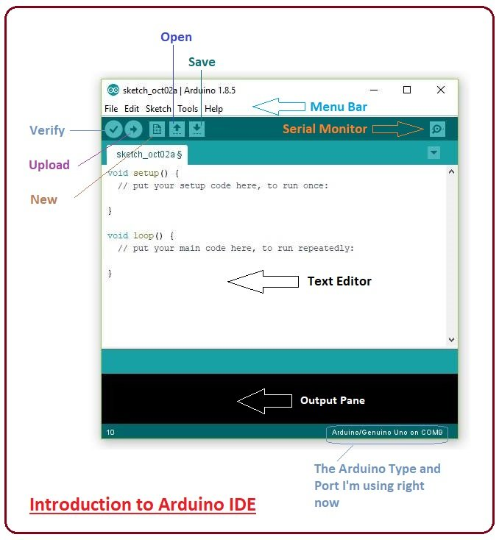
The Arduino IDE

Slide 8
The MENU BAR
The bar appearing on the top is called Menu Bar that comes with five different options as follows:
File – You can open a new window for writing the code or open an existing one. Following table shows the number of further subdivisions the file option is categorized into.

Slide 9
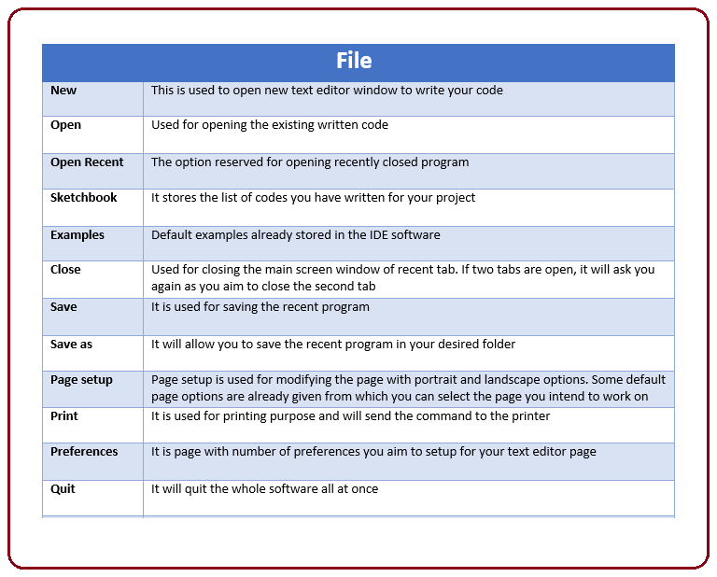
FILE

Slide 10
Other options in the menu bar
Edit – Used for copying and pasting the code with further modification for font
Sketch – For compiling and programming
Tools – Mainly used for testing projects. The Programmer section in this panel is used for burning a bootloader to the new microcontroller.
Help – In case you are feeling skeptical about software, complete help is available from getting started to troubleshooting.

Slide 11
Below the MENU BAR
The Six Buttons appearing under the Menu tab are connected with the running program as follows.
The check mark appearing in the circular button is used to verify the code. Click this once you have written your code.
The arrow key will upload and transfer the required code to the Arduino board.
The dotted paper is used for creating a new file.
The upward arrow is reserved for opening an existing Arduino project.
The downward arrow is used to save the current running code.
The button appearing on the top right corner is a Serial Monitor – A separate pop-up window that acts as an independent terminal and plays a vital role for sending and receiving the Serial Data.

Slide 12
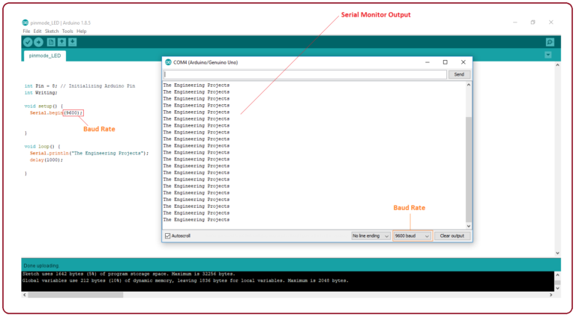
THE SERIAL MONItor
You need to select the baud rate of the Arduino Board you are using right now. For my Arduino Uno Baud Rate is 9600.

Slide 13
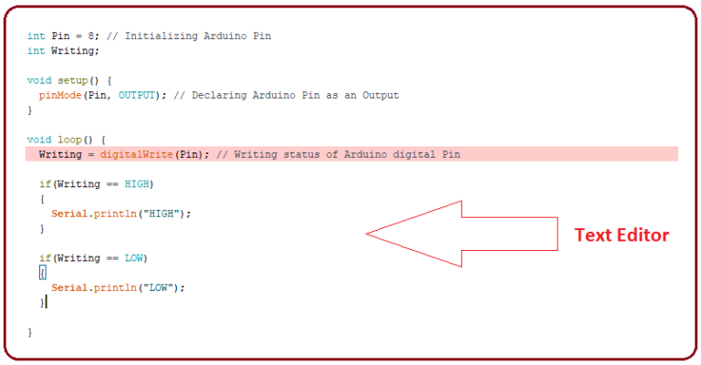
THE TEXT editor
The main screen below the Menu bard is known as a simple text editor used for writing the required code.

Slide 14
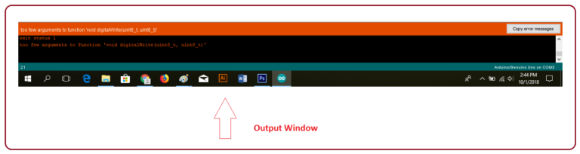
The output pane
The bottom of the main screen is described as an Output Pane that mainly highlights the compilation status of the running code: the memory used by the code, and errors occurred in the program. You need to fix those errors before you intend to upload the hex file into your Arduino Module.

Slide 15
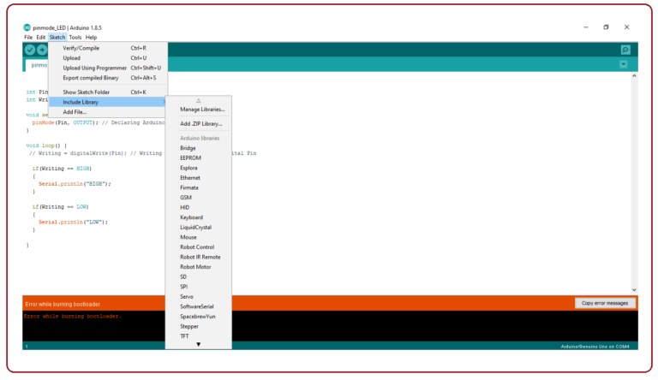
Arduino libraries
Libraries are very useful for adding the extra functionality into the Arduino Module. There are three ways to work for libraries:
Add libraries into the code by clicking on Sketch>Include Library>selecting the library

Slide 16
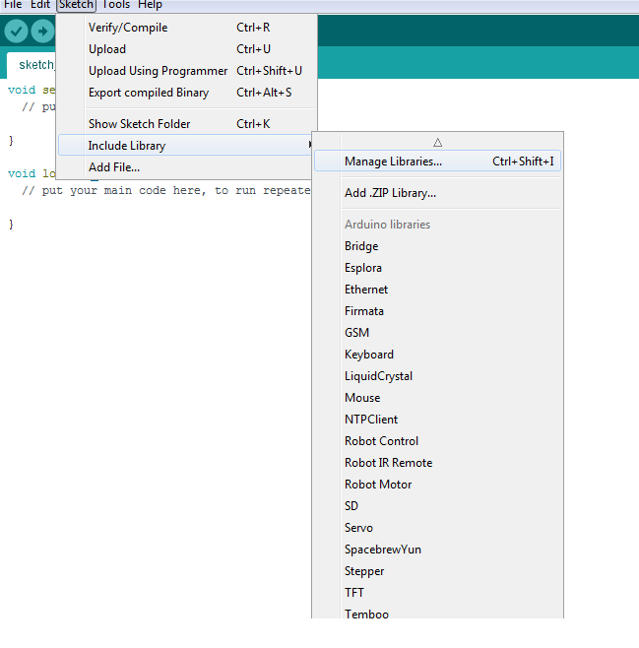
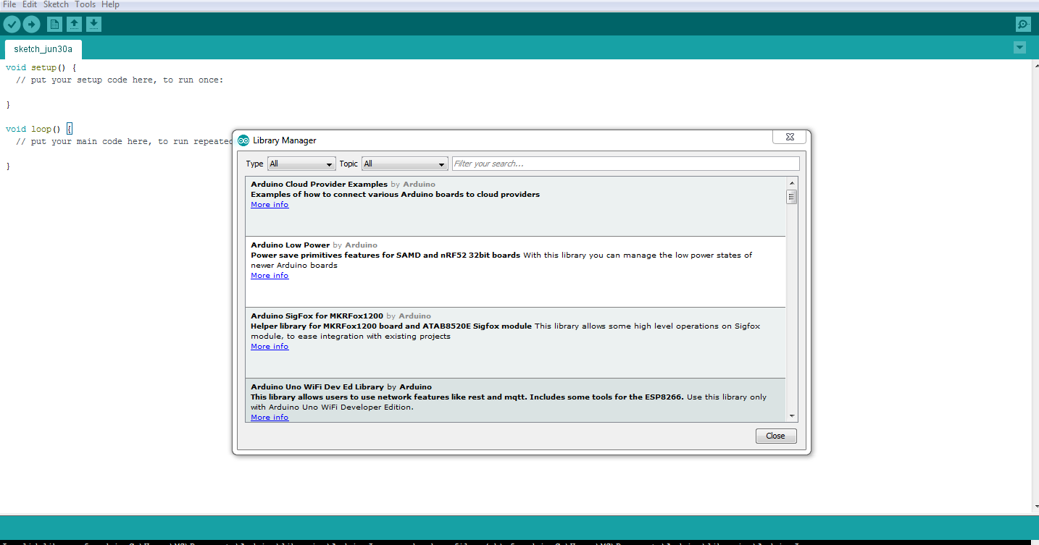
Arduino libraries
Add new libraries which are not pre-installed into your Arduino IDE by clicking Sketch>Include Library> Manage Libraries

Slide 17
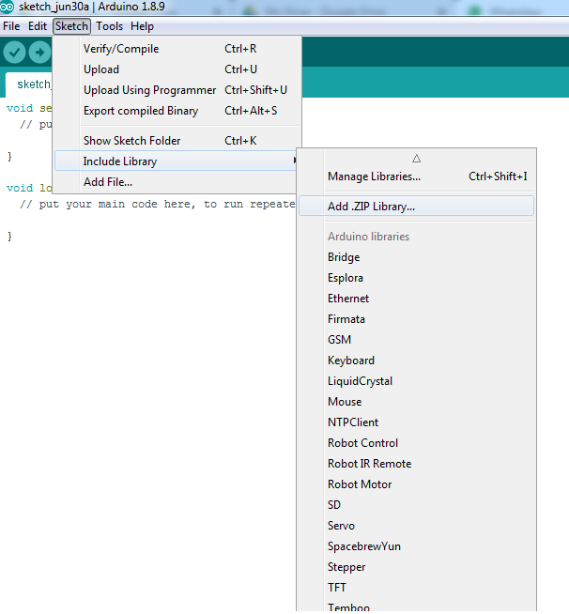
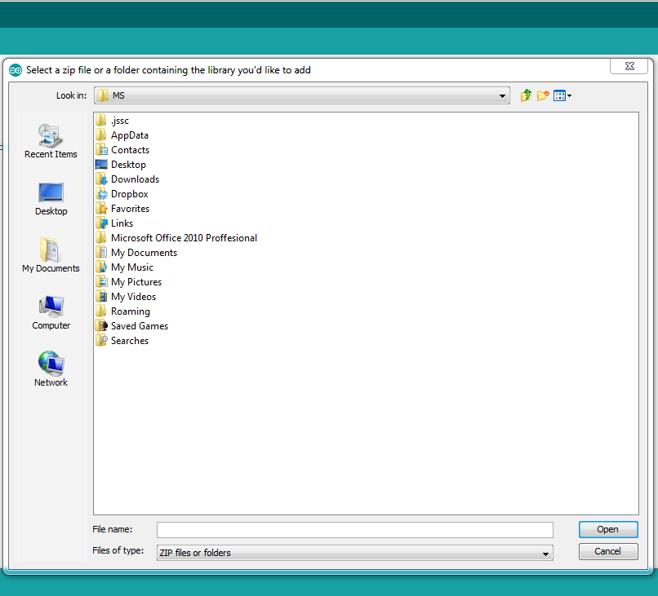
Arduino libraries
Adding libraries which are not pre-installed by clicking on Sketch>IncludeLibary>Add .zip library

Slide 18
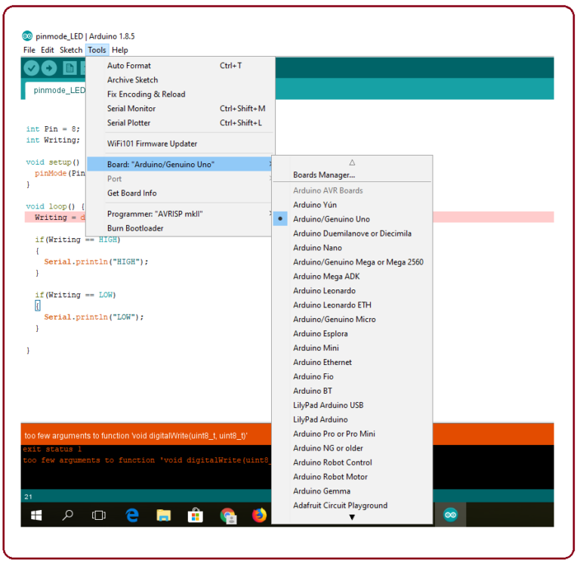
SELECTING THE BOARD

Slide 19
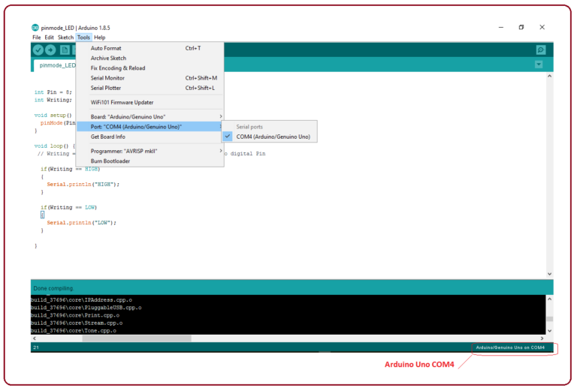
SELECTING THE COM-PORT

Slide 20
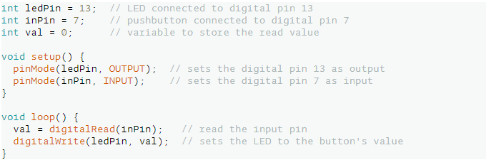
Arduino Functions-DIGITAL I/O
digitalRead(): Reads the value from a specified digital pin, either HIGH or LOW.
Syntax: digitalRead(pin);
Returns: HIGH or LOW

Slide 21
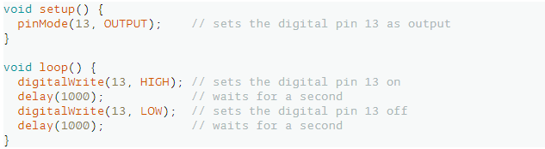
Arduino Functions-DIGITAL I/O
digitalWrite(): Write a HIGH or a LOW value to a digital pin.
Syntax: digitalWrite(pin, value);
Returns: Nothing.

Slide 22
Arduino Functions-DIGITAL I/O
pinMode(): Configures the specified pin to behave either as an input or an output.
Syntax: pinMode(pin, mode)
Returns: Nothing.

Slide 23
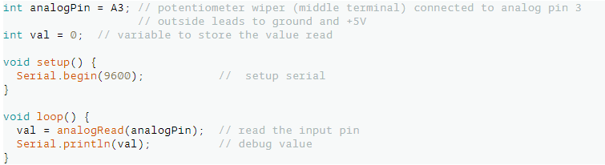
Arduino Functions-ANALOG I/O
analogRead(): Reads the value from the specified analog pin.
Syntax: analogRead(pin);
Returns: The analog reading on the pin. Although it is limited to the resolution of the analog to digital converter (0-1023 for 10 bits or 0-4095 for 12 bits).

Slide 24
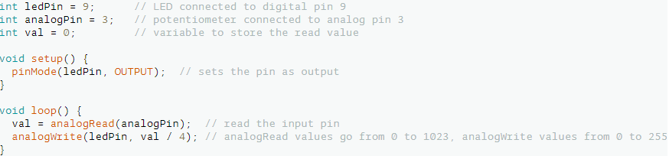
Arduino Functions-ANALOG I/O
analogWrite(): Writes an analog value(PWM wave) to a pin. Can be used to light a LED at varying brightness or drive a motor at various speeds.
Syntax: analogWrite(pin, value);
Returns: Nothing.

Slide 25
Arduino Functions-TIME
delay(): Pauses the program for the amount of time (in milliseconds) specified as parameter. (There are 1000 milliseconds in a second.)
Syntax: delay(time in ms);
Returns: Nothing.

Slide 26
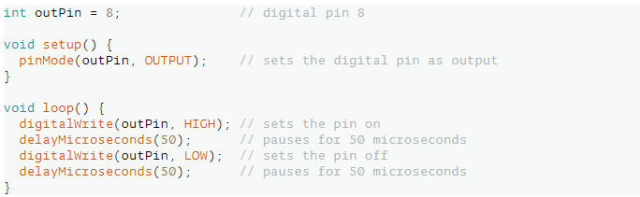
Arduino Functions-TIME
delayMicroseconds(): Pauses the program for the amount of time (in microseconds) specified by the parameter. There are a thousand microseconds in a millisecond and a million microseconds in a second.
Syntax: delayMicroseconds(time in microseconds);
Returns: Nothing.

Slide 27
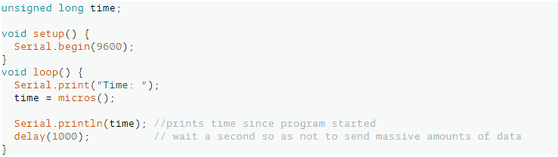
Arduino Functions-TIME
micros(): Returns the number of microseconds since the Arduino board began running the current program. This number will overflow (go back to zero), after approximately 70 minutes.
Syntax: time = micros();
Returns: Returns the number of microseconds since the Arduino board began running the current program. Data type: unsigned long.

Slide 28
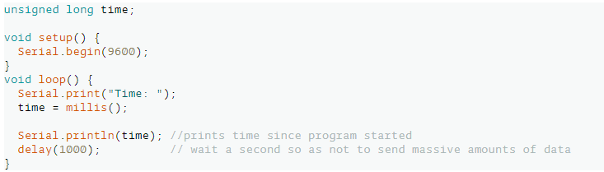
Arduino Functions-TIME
millis(): Returns the number of milliseconds passed since the Arduino board began running the current program. This number will overflow (go back to zero), after approximately 50 days.
Syntax: millis();
Returns: Number of milliseconds passed since the program started. Data type: unsigned long.

Slide 29
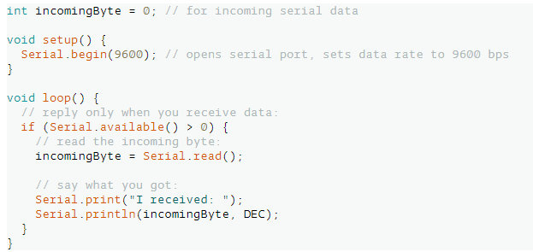
Arduino Functions-SERIAL COMMUNICATION
Serial.available(): Get the number of bytes (characters) available for reading from the serial port. This is data that’s already arrived and stored in the serial receive buffer (which holds 64 bytes).
Syntax: Serial.available();
Returns: The number of bytes available to read.
The following code returns a character received through the serial port:

Slide 30

Arduino Functions-SERIAL COMMUNICATION
Serial.begin(): Opens the Serial port and sets the data rate in bits per second (baud) for serial data transmission. For communicating with Serial Monitor, make sure to use one of the baud rates listed in the menu at the bottom right corner of its screen.
Syntax: Serial.begin(speed);
Returns: Nothing.

Slide 31
Arduino Functions-SERIAL COMMUNICATION
Serial.end(): Disables serial communication, allowing the RX and TX pins to be used for general input and output. To re-enable serial communication, call Serial.begin().
Syntax: Serial.end();
Returns: Nothing.
Serial.parseInt(): Looks for the next valid integer in the incoming serial. The function terminates if it times out. Parsing stops when no characters have been read for a configurable time-out value, or a non-digit is read; If no valid digits were read when the time-out (see Serial.setTimeout()) occurs, 0 is returned;
Syntax: Serial.parseInt();
Returns: Nothing.

Slide 32
Arduino Functions-SERIAL COMMUNICATION
Serial.setTimeout(): Serial.setTimeout() sets the maximum milliseconds to wait for serial data. It defaults to 1000 milliseconds.
Syntax: Serial.setTimeout(timeinmilliseconds);
Returns: Nothing.

Slide 33
Arduino Functions-SERIAL COMMUNICATION
Serial.print(): Prints data to the serial port as human-readable ASCII text. This command can take many forms.
Syntaxes: Serial.print(value), Serial.print(value, format)
Returns: Nothing.
Numbers are printed using an ASCII character for each digit. Floats are similarly printed as ASCII digits, defaulting to two decimal places. Bytes are sent as a single character. Characters and strings are sent as is. For example-
Serial.print(78) gives "78"
Serial.print(1.23456) gives "1.23"
Serial.print('N') gives "N"
Serial.print("Hello world.") gives "Hello world.”

Slide 34
Arduino Functions-SERIAL COMMUNICATION
An optional second parameter specifies the base (format) to use; permitted values are BIN(binary, or base 2), OCT(octal, or base 8), DEC(decimal, or base 10), HEX(hexadecimal, or base 16). For floating point numbers, this parameter specifies the number of decimal places to use. For example-
Serial.print(78, BIN) gives "1001110"
Serial.print(78, OCT) gives "116"
Serial.print(78, DEC) gives "78"
Serial.print(78, HEX) gives "4E"
Serial.print(1.23456, 0) gives "1"
Serial.print(1.23456, 2) gives "1.23"
Serial.print(1.23456, 4) gives "1.2346"

Slide 35
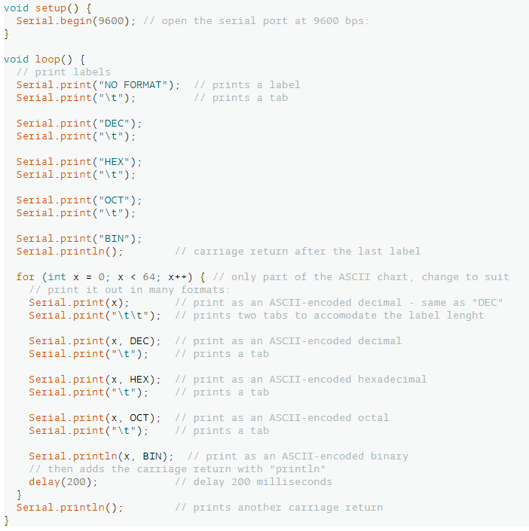
Arduino Functions-SERIAL COMMUNICATION

Slide 36
Arduino Functions-SERIAL COMMUNICATION
Serial.println(): Prints data to the serial port as human-readable ASCII text followed by a carriage return character (ASCII 13, or '\r') and a newline character (ASCII 10, or '\n'). This command takes the same forms as Serial.print().
Syntaxes:
Serial.println(val)
Serial.println(val, format)
Returns: Returns the number of bytes written, though reading that number is optional.

Slide 37
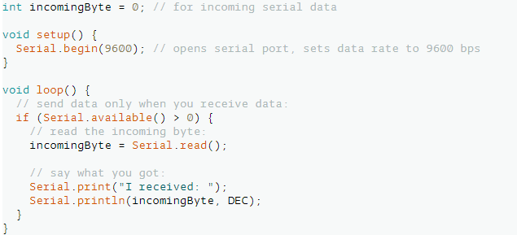
Arduino Functions-SERIAL COMMUNICATION
Serial.read(): Reads incoming serial data.
Syntax: Serial.read();
Returns: The first byte of incoming serial data available (or -1 if no data is available). Data type: int.

Slide 38
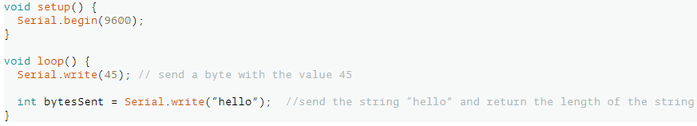
Arduino Functions-SERIAL COMMUNICATION
Serial.write(): Writes binary data to the serial port. This data is sent as a byte or series of bytes; to send the characters representing the digits of a number use the Serial.print() function instead.
Syntax: Serial.write();
Returns: Returns the number of bytes written, though reading that number is optional.

Slide 39
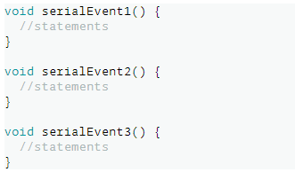
Arduino Functions-SERIAL COMMUNICATION
serialEvent(): Called when data is available. Use Serial.read() to capture this data.
Syntax:
void serialEvent()
{
//statements
}
Returns: Nothing.

Slide 40
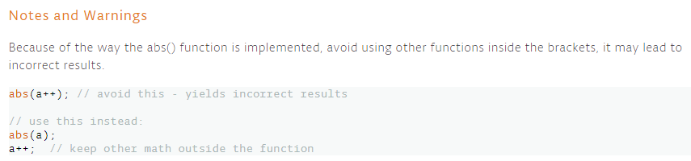
Arduino Functions-Mathematical Functions
abs(): Calculates the absolute value of a number.
Syntax: abs(x)
Returns:
x: if x is greater than or equal to 0.
x: if x is less than 0.

Slide 41
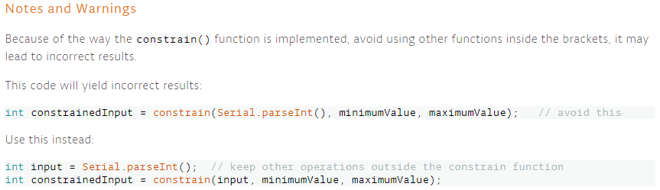
Arduino Functions-Mathematical Functions
constrain(): Calculates the absolute value of a number.
Syntax: constrain(x, a, b);
Returns:
x: if x is between a and b.
a: if x is less than a.
b: if x is greater than b.

Slide 42
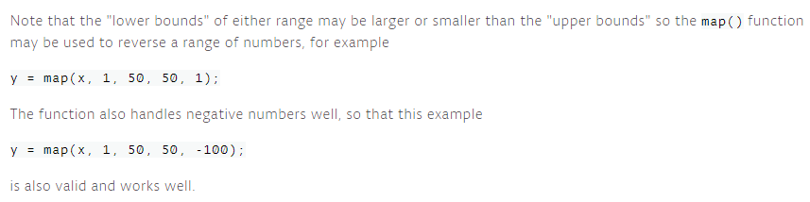
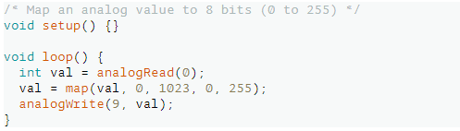
Arduino Functions-Mathematical Functions
map(): Re-maps a number from one range to another. That is, a value of “fromLow” would get mapped to “toLow”, a value of “fromHigh” to “toHigh”, values in-between to values in-between.
Syntax: map(value, fromLow, fromHigh, toLow, toHigh);
Returns: The mapped value.

Slide 43

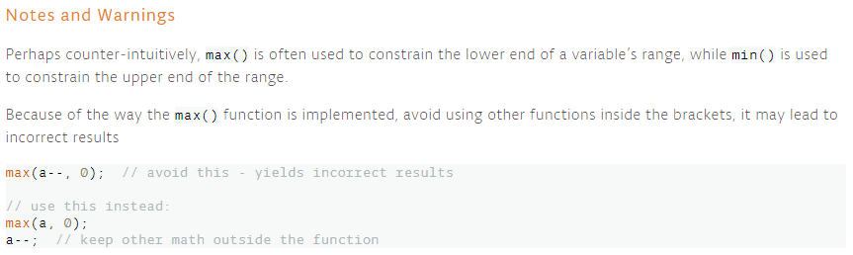
Arduino Functions-Mathematical Functions
max(): Calculates the maximum of two numbers.
Syntax: max(x, y);
Returns: The larger of the two numbers (x and y).

Slide 44

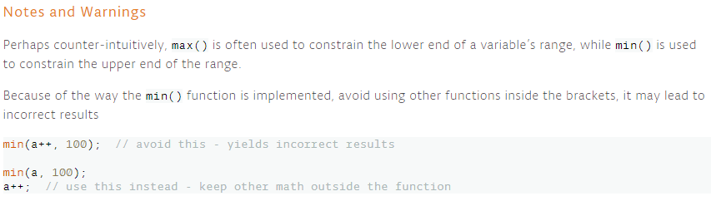
Arduino Functions-Mathematical Functions
min(): Calculates the minimum of two numbers.
Syntax: min(x, y);
Returns: The smaller of the two numbers(x and y).

Slide 45
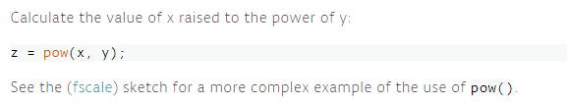
Arduino Functions-Mathematical Functions
pow(): Calculates the value of a number raised to a power. pow() can be used to raise a number to a fractional power. This is useful for generating exponential mapping of values or curves.
Syntax: pow(base, exponent)
Returns: The result of the exponentiation. Data type: double.

Slide 46
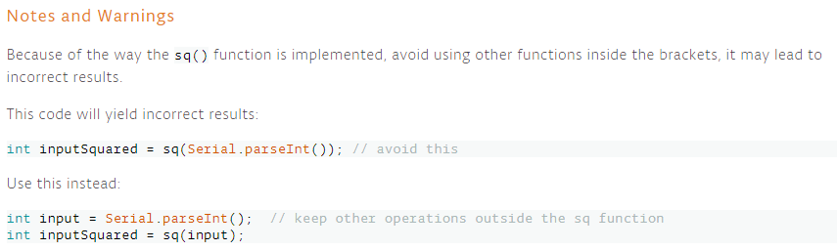
Arduino Functions-Mathematical Functions
sq(): Calculates the square of a number: the number multiplied by itself.
Syntax: sq(x);
Returns: The square of the number. Data type: double.

Slide 47
Arduino Functions-Mathematical Functions
sqrt(): Calculates the square root of a number.
Syntax: sqrt(x);
Returns: The number’s square root. Data type: double.

Slide 48
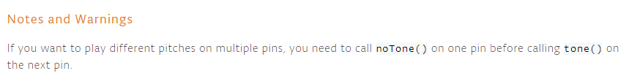
Arduino Functions-ADVANCE i/o
tone(): Generates a square wave of the specified frequency (and 50% duty cycle) on a pin. A duration can be specified, otherwise the wave continues until a call to noTone(). The pin can be connected to a piezo buzzer or other speaker to play tones. Only one tone can be generated at a time. If a tone is already playing on a different pin, the call to tone() will have no effect. If the tone is playing on the same pin, the call will set its frequency. Use of the tone() function will interfere with PWM output on PWM pins. It is not possible to generate tones lower than 31Hz.
Syntax:
tone(pin, frequency), tone(pin, frequency, duration);
Returns: Nothing.

Slide 49
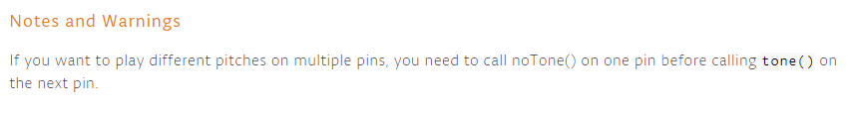
Arduino Functions-ADVANCE i/o
noTone(): Stops the generation of a square wave triggered by tone(). Has no effect if no tone is being generated.
Syntax: noTone(pin);
Returns: Nothing.

